Slide 1
Test data
Find it use it love it

Slide 2
Test data
Create a piece of code and run it
What if it doesn’t work?

Slide 3
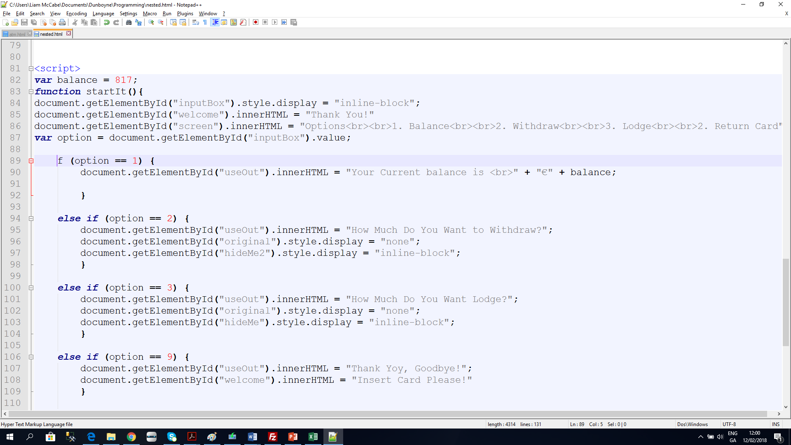
Test data
Create a piece of code and run it
What if it doesn’t work?

Slide 4
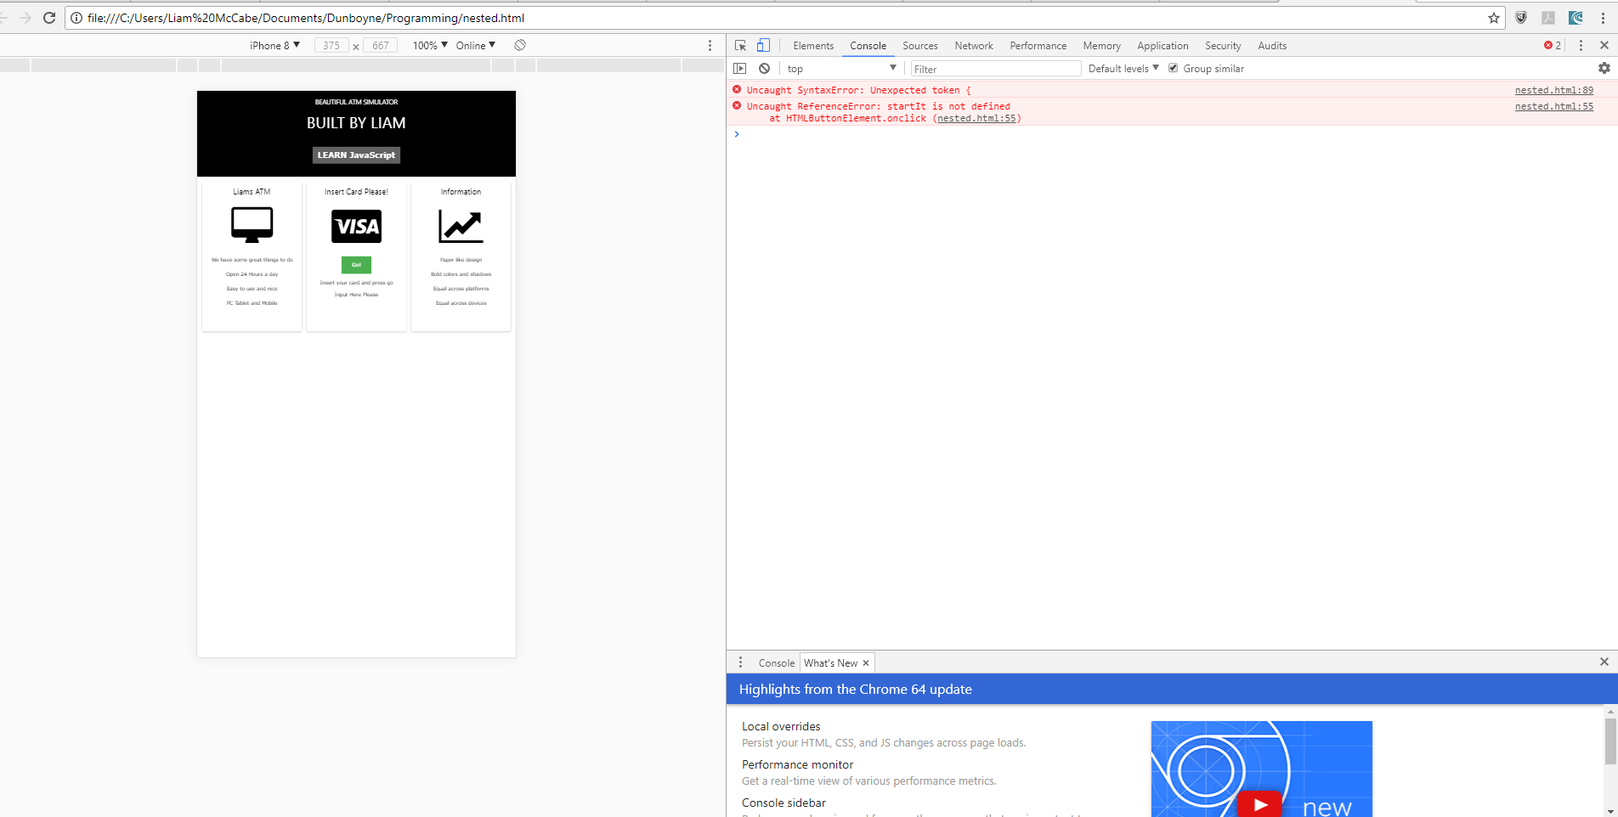
Test data
Create a piece of code and run it
What if it doesn’t work?

Slide 5
Test data
Console
Press Ctrl+Shift + J

Slide 6
Test data
Console
The console will identify reasons why the code didn’t work

Slide 7
Test data
Record Results
At the first instance of the run we encountered ….

Slide 8
Test data
Modify results
At the Second instance of the run after modifying….

Slide 9
Test data
Record outputs
We got NAN

Slide 10
Test data
Record outputs
This was due to text input fin which should have been parseInt(fin)

Slide 11
Test data
Record What happened
Throughout every step even if it works

Slide 12
Test data
Record What happened
Test many variables of the code and record all outputs

